Slide 1

Peer Programming
Name: Aawan Adhikari
ID: 12204076

Slide 2
Checking of the Authorized Application
In this project, we have to configure Windows Defender Application Control(WDAC) in the virtual machine called Windows11.
By using different tools, we can see if the WDAC checks if the apps is Authorized or not.
WDAC Blocks if the app is unauthorized

Slide 3
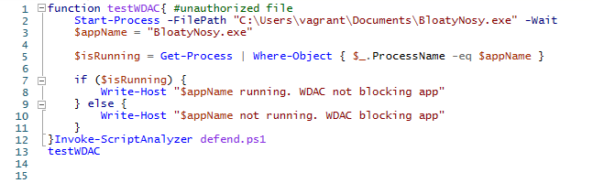
This is the code that was done in Power Shell of the Windows 11 virtual machine.

Slide 4
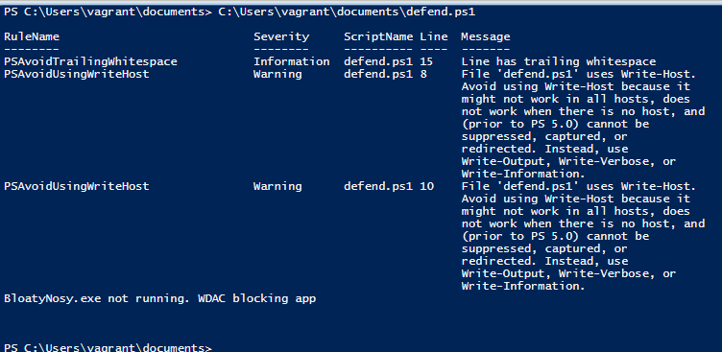
This is the output after running the above code.
The output says “ BloatyNosy.exe not running. WDAC Blocking app.
This means WDAC is working, and it is blocking unauthorized apps.
Also, there are other rules and messages as the code is using Script Analyzer.

Slide 5
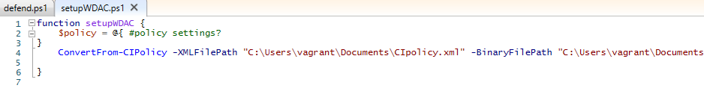
Setting up WDAC

Slide 6
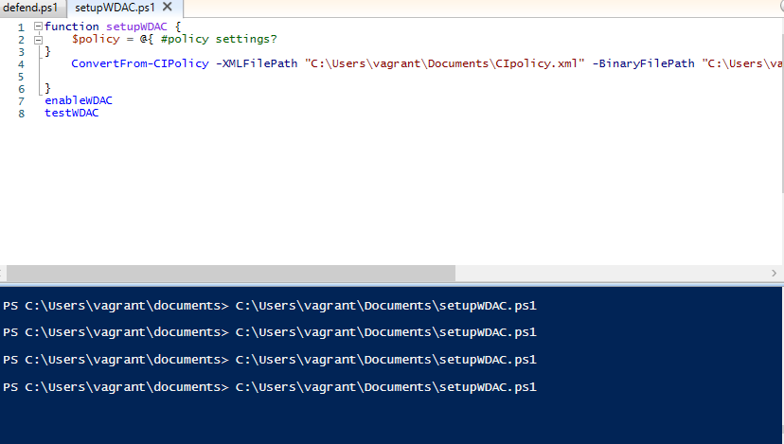
After setting up the WDAC, now we need to enable and test WDAC.
After running the code, we can see that the code did not generate any error and other warning comments.

Slide 7
https://github.com/AawanAdhikari/Cyber-Security.git This is my link to the Git Hub repository.

